Slide 1
Mixed methods:
Should we be using them?
Michael Hammond
Kazakhstan 2023

Slide 2

Today we will
Describe mixed methods
Think about where mixed methods sits
Think about mixed methods in our research
Picture: https://pixabay.com/photos/mosaic-tiles-template-texture-3394375/

Slide 3

You and mixed methods
What experiences / plans do you have about using mixed methods?

Slide 4
Quantitative, qualitative and mixed methods
Quantitative - data in the form of number
Qualitative - data in the form of text, images, objects
Mixed methods simply refers to two or more methods of data collection

Slide 5
Some examples
Learning through online discussion: A case of triangulation in research:
A study of a distance learning module, for part time students, on the topic of e-business, within an MBA programme
Key questions: What was students’ overall evaluation of the e-business module? How did students conduct their group work? How was tutor support provided? How did students characterise the learning experience?
Methods
  online questionnaire survey, message analysis and face to face interview

Slide 6
Kazakh example
School leadership and capacity building in Kazakhstan Yakavets et al (2015)
The overall 2014 research project was a mixed-methods study drawing on semi-structured interviews, focus groups and a survey as well as the analysis of documents published by the MoES, NIS and regional departments of education.

Slide 7

There are many methods
Obvious is interviews plus survey
But think about: big data, content analysis, delphi method, diaries, meta-analysis, neuroimaging (actigraphs), shadowing, GPS tracking, document analysis, test scores, observations, visual methods

Slide 8
Mixed methods can be broken down by
  Type / number of methods
  Balance between methods
  Concurrent, sequential approaches to planning, data collection and analysis
  Degree to which integrated

Slide 9

Type and number
Is in the context of research question
Some questions are about perspectives and imply interviews, questionnaires, diaries (affective)
Some are about what you do and imply observation or analytics (behaviour)
Some are about what you know and imply testing (cognition)

Slide 10

Balance of methods
A survey with some interview data v a survey with in depth interview data
Learning analytics some illustrative survey data v learning analytics to support a survey
In depth interviews with a brief wider context (documentary data)

Slide 11
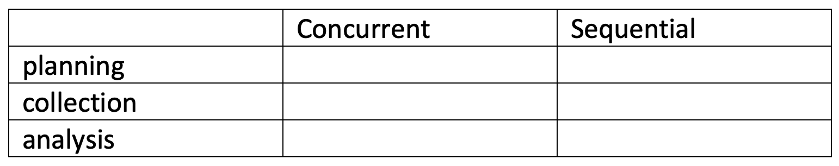
Concurrent or sequential?
Concurrent: one feeds into the other
Sequential: easier to manage
Most decisions are a matter of context

Slide 12

Degree to which integrated
Data presented separately in the findings and only integrated at the end
Chapter 4 interview findings
Chapter 5 survey findings
Chapter 6 interviews and surveys combined
Or data integrated within the findings:
Chapter 4 findings

Slide 13
Integrated text
Attitudes to technology
Participants explained they were positive about technology, for example one said she was ‘into technology and that iphones were her life’ (Student X). Others said they simply saw technology as the new normal.
They further reported that they were confident users of digital tools, and this was borne out when observing their use of computers in the classrooms and iphones outside of work.
Some considered themselves particularly resourceful and determined when getting to use a new item of software and this was seen in observation of the new whiteboards.
The survey backed up the interviews, most participants reported that they were very confident in using technology (see table x)

Slide 14
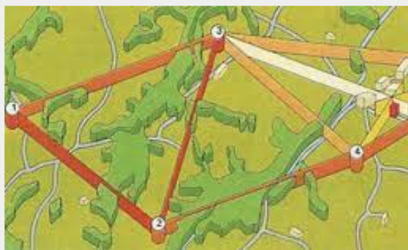
Triangulation
A key word
You can formally compare and contrast data
Could be both groups and methods
Not to be used mechanistically
Don’t be biased towards confirmability rather than contrast, and complementarity
Requires imagination

Slide 15
It can be interesting…
…to contrast what we do with what we think we do (A and B) e.g.
Interviews and GPS tracking
Observation with video diaries
Learning analytics and survey questionnaire

Slide 16
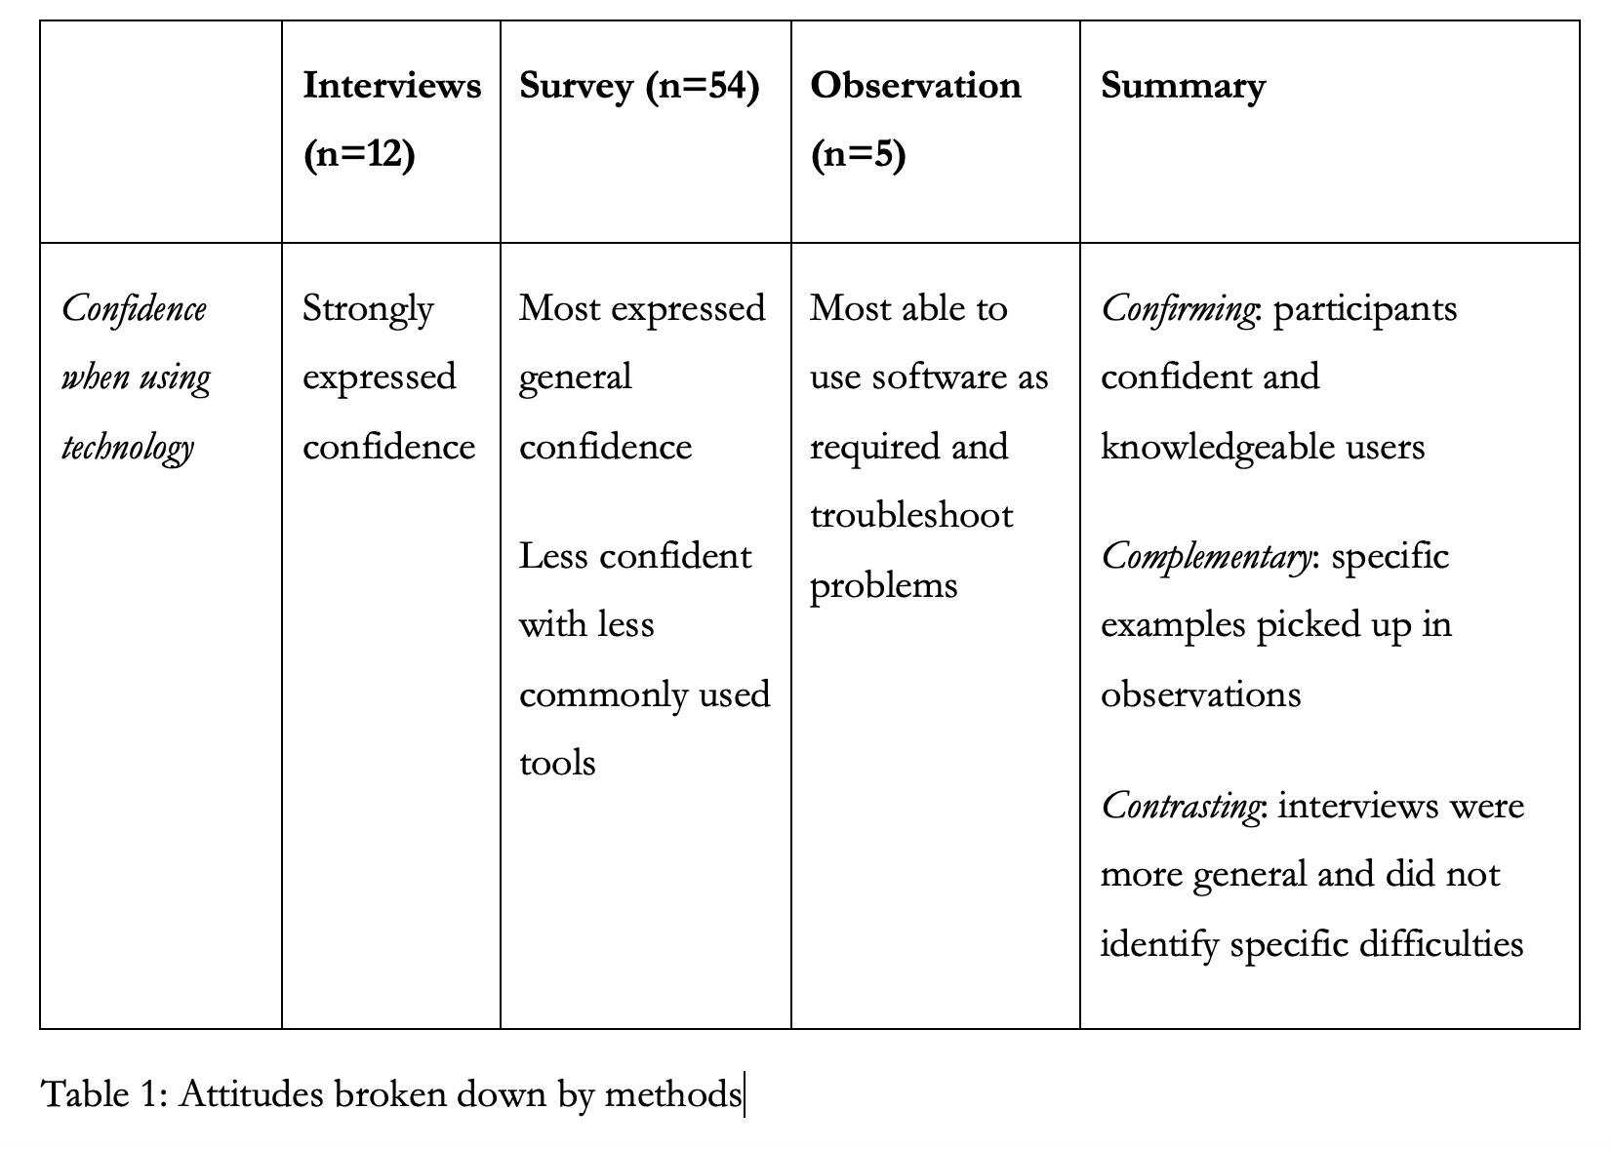

Slide 17
In using a method
Note opportunities, e.g. to go deep, to get accurate description of behaviour, to go broad.
Note tensions between, say, going for breadth and depth (surveys), or accessing only digital data (analytics)
Raise ethical issues about processes and anonymising data
Note it is all about the context and the question

Slide 18
In using a method/
Discuss issues of validity / reliability or trustworthiness and ways of reducing researcher bias, e.g. inter-rater reliability checks, Cronbach's alpha, discussion of positionality

Slide 19
Be specific about steps taken
Open Coding (Broad-brush)
Data Reduction Cycle
(Codes to Sub-categories and Categories)
Presentation Cycle
Coded 4 transcripts.
Compared codes between two coders.
Applied the codes to remaining transcripts, while open to new codes.
Resulting in 87 codes.
Further refinement on codes.
‘Structural coding’ combining codes into bigger groups.
Groups became Sub-categories.
Several Sub-categories combined to make Categories.
Resulting in 12 Categories and 40 Sub-categories.
Arranged under 4 themes.
Some mediating categories e.g. ‘Extrinsic’, ‘Intrinsic’.
Some re-positioning of codes.

Slide 20
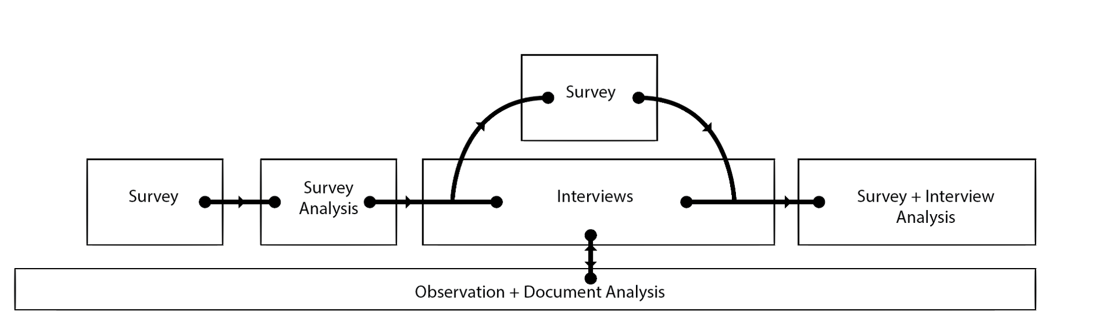
And when and how methods were mixed

Slide 21
The logic is in the research question
But do we ask questions with methods in mind or do we have methods in mind when we ask questions?
‘To someone with a hammer every problem concerns a nail’

Slide 22

Why mixed methods?
Combines breadth and depth
More trustworthy
Invites reflexivity
Flexible
Difficult to see why not on principle

Slide 23
But there is a why not..
Using some methods badly
Lack of time
Unthinking / artificial application
Some methods ruled out e.g. hard to reach populations
May be used with ‘confirmability’ in mind
Mixed for the sake of being mixed

Slide 24
And mixed methods is not a methodology
When we talk about research design we often talk about
ontology: ‘what the world is’
epistemology: how we can knowledge of the world’
methodology: the general approach to the problem
methods: the particular tools being used

Slide 25
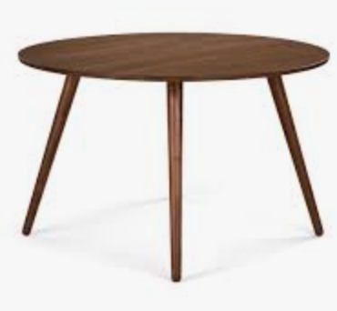
Ontology: What the world is
Objectivism or realism
Subjectivist or socially constructed
Or bit of each e.g. critical realism, pragmatism

Slide 26

Epistemology: gaining knowledge of the world
Interpretivism – aims to understand perspectives, a uniquely human science
Positivism – tools of natural science work in social science
Pragmatism – through action and problem solving we will understand the world

Slide 27

Methodology
The rationale for the design in relation to the research question.
For example, 'how many' type questions suggest a survey methodology; 'how can I improve' questions suggest action research; 'is this approach better than that...' suggests an experimental design and so on.

Slide 28
Methodology gives the bigger picture
Methodology: Systematic review, meta-analysis, large N studies, Big Data; survey research, secondary data analysis, action research, Experimental, exploratory innovations, narrative, life history, evaluative enquiry / experimental study / comparative study, ethnographic immersion

Slide 29
Many different types of methodology
Make sure you have articulated a methodology and know its strengths and weaknesses
Explain why it is particularly appropriate for your study
Discuss the ethics e.g. experimental study

Slide 30
Methods are the nuts and bolts
Methods: Interviewing, survey, observation but also think big data, content analysis, Delphi method, diaries meta analysis, neuroimaging, shadowing, GPS tracking….
To say you are doing a mixed methods study is not very interesting or surprising

Slide 31
But if you want to…
Try ‘A research paradigm whose time has come’*
Researchers have more in common than think, e.g. most are weak relativists
Argues for a mixed methods and mix of inductive and deductive analysis
Sees eclecticism, complementarity, inclusivity as important
Key dimensions to mixed methods: concurrent or sequential; equal or dominant
*Johnson, R., & Onwuegbuzie, A. (2004). Mixed methods research: A research paradigm whose time has come. Educational Researcher, 33(7), 14 -26.

Slide 32
or
Creswell, J. W., & Creswell, J. D. (2017). Research design: Qualitative, quantitative, and mixed methods approaches. London: Sage.
Be aware of say
Journal of mixed methods research
International journal of mixed methods research
Think about writing about your methods not just your findings

Slide 33

Would you use mixed methods in your research?
If not, why not?
If so which methods, in what order, with what underpinning rationale?
Source: https://pixabay.com/photos/laptop-apple-macbook-computer-2557571/

Slide 34
To discuss
Are you a fan of mixed methods?
Do you think much about ontology / epistemology?
How would you justify a mixed methods approach?

