Slide 1

Getting published
Michael Hammond

Slide 2
I would like to think about
Experiences of writing papers
Opportunities for writing papers
Challenges to get accepted
Tips for writing
Suggestions for support

Slide 3

Experiences
What are your experiences of writing papers / planning to write papers?
Straightforward / challenging
Main barriers
Main opportunities

Slide 4

Opportunities
Host of journals
We have something to write about
We have access to journals and papers to model from
In many case access to reviewing

Slide 5

Constraints
May not know what the reviewers are looking for
Dealing with ‘predatory’ journals
Having to find the ‘right’ journals
Under pressure to publish, does not got the time or space to think
Simply not enough time

Slide 6

Strategies
Think about the paper while doing the research
Think about what kind of paper(s) to write e.g.:
  Straight reporting of findings
  Theoretical contribution based on reading of literature and / or case study
  Literature review – systematic or narrative
  Methodological contribution

Slide 7

Think about the journal
Look carefully at the journal aims
Look at past papers
Perhaps write to editor if not sure
Consider special issues

Slide 8
Example
Technology, Pedagogy and Education ….It explores the particular contribution that educational technology can make to educational environments, focusing on empirical evidence derived from both quantitative and qualitative research designs, and on a critical analysis of the ways in which new technologies can support learning and teacher professional development in all phases of education.

Slide 9
Writing the paper
Many journals will have a variation of Title, Abstract, Introduction, Methodology, Findings (results), Discussion. But this is not universal so check.
Journals will have clear guidelines for format e.g. double lined, figures at back and so on
Editors will also have expectations in regard to language level and presentation

Slide 10
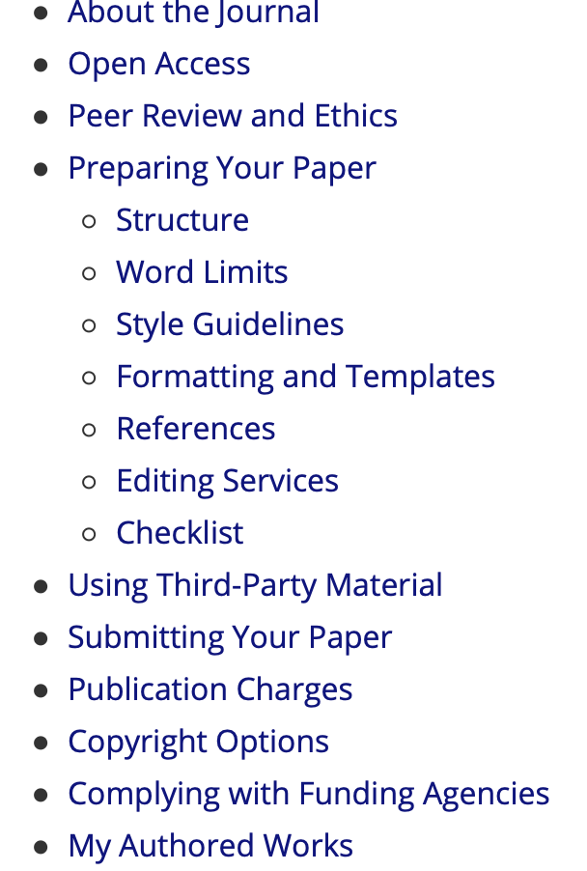
Preparing your MS

Slide 11

Why you may not get accepted
Simple bad luck, wrong reviewers, trying to get into an already established field
Wrong time, does not feel new
Fashions change e.g. action research, case study
Presentation unclear – halo effect

Slide 12
But a more analytical explanation is…
The paper feels local, the significance is not brought out either because of narrowness of data or lack of theorisation.
It does not address the key reviewer question ‘ why should I be interested in this?’
(remember the reviewer may be in a different country, may have a different slant on the topic and above all is short of time)

Slide 13
How can you address these issues?
Make the significance clear in the abstract
This is a study of MOOCs and the opportunities they provide for non-traditional learners to access education. It explores why learners, who are not themselves already in higher education, sign up for these courses and what they get out of their learning experience.
The study addressed four key questions: ‘What experiences did these learners have?’; ‘What did they see the opportunities for learning?’; ‘What did they see as constraints on learning?’; ‘What did they learn through their participation?’. etc.

Slide 14
Introduction
The big idea underlying the research, the key concepts and theories related to study as well as an indication of the practical and academic areas to which the study contributes
This could contain a guide to the paper
Should be brief, and not replicate the literature review

Slide 15

Literature review
Comment critically
Careful about strings of references
Make sure you have really read them
The key concept(s)
The identification of a gap
Leading to the research question (s) or hypothesis
Trawl the particular journal for anything relevant

Slide 16

Methodology
Make sure you have articulated a methodology and know the strengths and weaknesses
Explain why it is particularly appropriate for this study
(In my experience it is impossible to convince a reviewer about methodology if their mind is made up)
Then talk about methods
Be specific about processes (including coding and analysis) and discuss issues of validity / reliability or trustworthiness
Short piece on ethics

Slide 17
Getting methodology and method right
It is not always so clear but in general methodology is the design and methods are the ways in which data are collected.
Methodology: survey, experimental research, narrative inquiry, action research, ethnography, Big Data
Methods: interviews, observations, tracking, content analysis questionnaires, diaries.

Slide 18

Findings / Results
Be economical (if quantitative you may often provide the data in separate file) produce the key findings in the paper itself
If qualitative perhaps provide tables of codes, select quotes carefully and explain what they signify
Again note the ‘halo effect’

Slide 19
Explain the tables
Table 1 presents descriptive statistics on the sample. It shows the proportion of pupils within each group for each pupil background variable and also the mean age 11 test score for each group. The results indicate substantial associations between the pupil background variables and age 11 average test score. The strongest associations, not surprisingly, are for prior achievement, with a difference of –2.2 SD between pupils in the top and bottom quintiles at age 7, and SEN with a difference of –1.3 SDbetween pupils with and without SEN….(Strand)

Slide 20
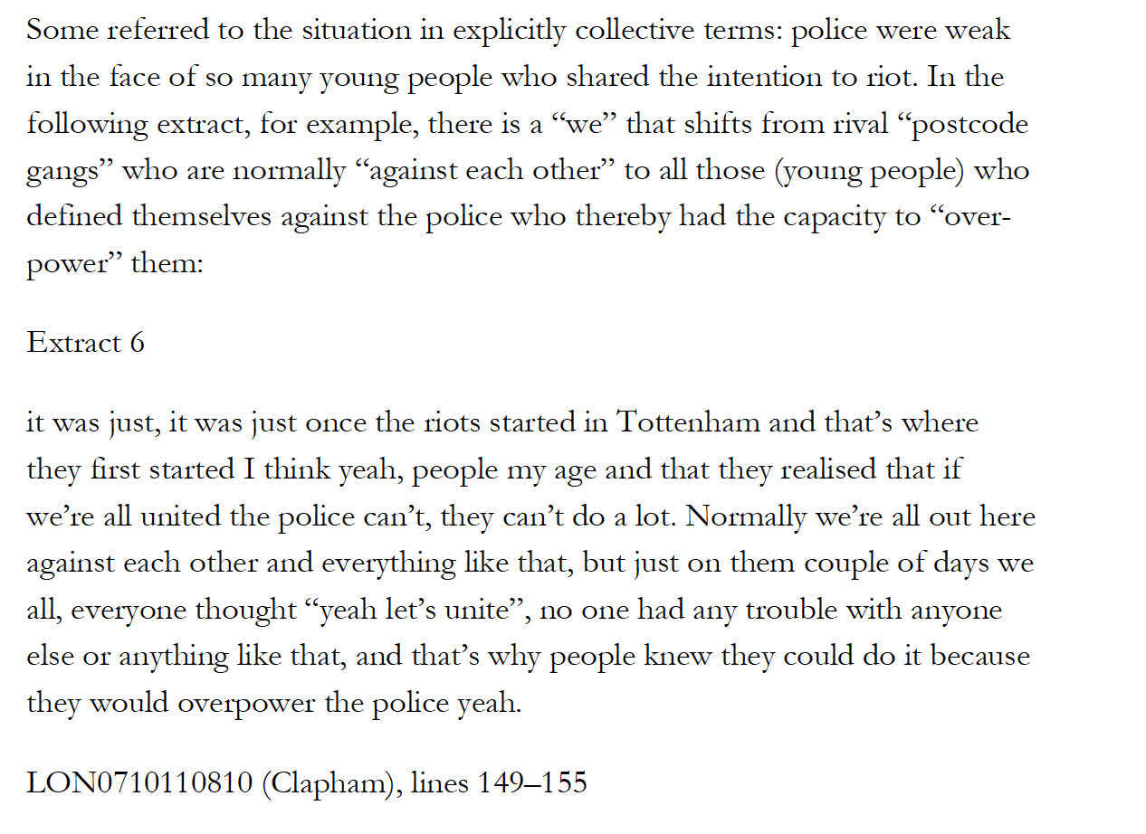
This is an example of a qualitative paper on riots in UK, the quote is introduced and then given the source located

Slide 21
Discussion
Address the research question(s) explicitly:
‘This paper began by asking if VR can help learners of English, the answer is yes, but with qualifications.’
Link the claims to the data (but don’t repeat the detail)
Link the study to the literature
Produce a new model or theoretical concept of your own if that is what you want to do.

Slide 22

Before you submit
Get it peer reviewed
Check you are following conventions exactly
Sit on it, don’t send it right away

Slide 23
Dealing with feedback
Rejected, before or after review
‘not ‘strong enough’, not interesting enough to the editor, too small a scale the general relevance not shown’
Perhaps you may just have to accept this but is there is something else from the study you may work on?
Or, show the general relevance, can you sell it to another reviewer?

Slide 24
Amendments
Major amendments could go either way but do them
Minor amendments do them as soon as you can
Accept as is – wait for proofs

Slide 25
Do some schools narrow the gap (Strand)
Studies of expansive learning: Foundations, findings and future challenges (Engestrom)
When are we going to have the real school? A case study of early childhood education and care teachers’ experiences surrounding education during the COVID-19 pandemic (Dayal and Tiko)
Age factor in foreign language education at preschool level (Orhan Kocaman &Nurgül Kocaman)
These are all papers showing different types of research and approaches, where would you rate them for:
Depth of understanding of subject matter?
Understanding of theory and its application to the study?
Clarity over methodology and methods?
Validity or appropriateness of context and sample?
Application of standard tests for reliability or processes to establish trustworthiness?
Depth and criticality of the discussion?
Presentation (general flow, precision of language, correct citations)
Find at https://mickhammond.blog/kazakstan-resources/getting-published/

Slide 26
Anything helpful here? Any questions?
Experiences of reviewing papers?
Responding to reviews?
Does the process seem fair and reasonable?
How can we better support each other writing papers?

